Slide 1

Midwestern University
A graduate healthcare education institution
Campus Locations:
Glendale, AZ:
144-acre campus located 15 miles northwest of Phoenix
Downers Grove, IL:
105-acre campus located 25 miles west of Chicago

Slide 2
Glendale Campus Programs
Arizona College of Osteopathic Medicine (D.O.)
College of Pharmacy, Glendale (Pharm.D.)
College of Dental Medicine-Arizona (D.M.D.)
Arizona College of Optometry (O.D.)
College of Veterinary Medicine (D.V.M.)
Arizona College of Podiatric Medicine (D.P.M.)

Slide 3
Glendale Campus Programs
College of Health Sciences
    Physician Assistant Studies (M.M.S.)
    Physical Therapy (D.P.T.)
    Occupational Therapy (M.O.T.)
    Cardiovascular Science/Perfusion (M.S.)
    Nurse Anesthesia (D.N.A.P.)
    Clinical Psychology (Psy.D.)
    Speech-Language Pathology (M.S.)
    Master of Science in Nursing (M.S.N.)
    Doctor of Nursing Practice (D.N.P.)
College of Graduate Studies
    Biomedical Sciences (M.A., M.B.S.)
    Public Health (M.P.H.)
    Precision Medicine (M.S.)

Slide 4
On-Campus Clinics
  Dental Institute:
  Denture
  General Dental Care
  Oral Surgery
  Pediatric Dentistry
  Specialty Services
  Diabetes Management
  Eye Institute
  Frames & Sunglasses
  Contact Lenses
  Dry Eyes
  Glaucoma
  Pediatrics
  Animal Health Institute
  Companion Animal Clinic
  Large Animal Clinic
  Diagnostic Pathology Center
  Multispecialty Institute:
  Family Medicine
  Foot & Ankle
  Pharmacy Services
  OMM
  Sports Medicine Services
  Diabetes Management
  Clinical Procedures
  Therapy Institute:
  Clinical Psychology
  Occupational Therapy
  Physical Therapy
  Speech-Language Therapy
  Low Vision & Visual Rehabilitation
  Sports Vision
Notes:
Clinics across the street include…
Clinical side vs. academia side.

Slide 5
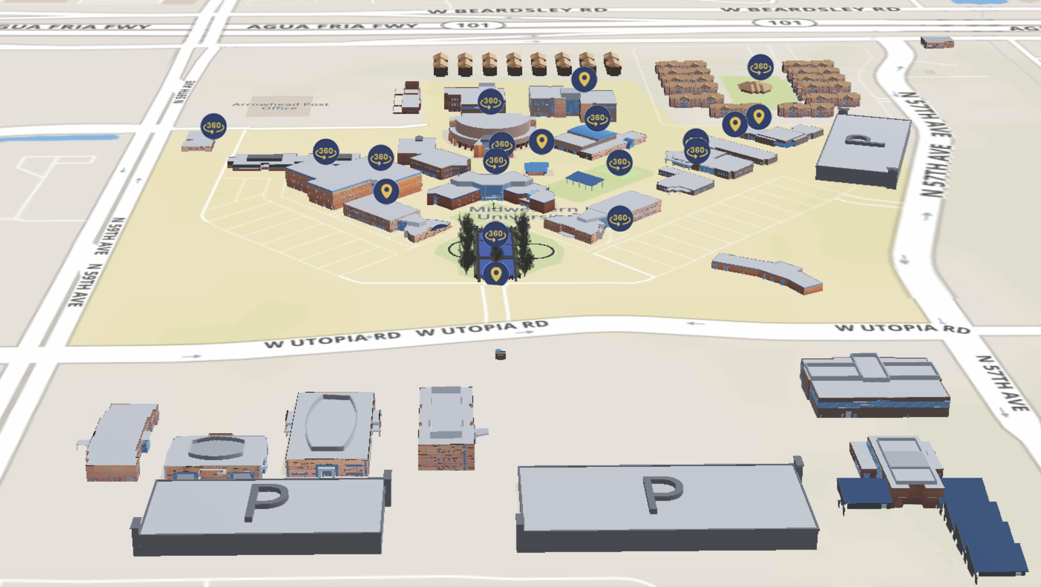
9
10
Glendale, Arizona Campus
23
9
25
8d
19
22
8c
D
20
4
21
8b
A
11
24
18
7
8a
6
5
F
E
3
17
1
2
16a
14
15
12
13
16b
C
16C
B

Slide 6
Admissions Requirements
Bachelor’s degree from a regionally accredited college or university prior to matriculation
(highly recommended; PH, PD and VET)
Minimum Cumulative GPA and Science GPA
Standardized Entrance Exam: MCAT, OAT, GRE or DAT
Prerequisite Coursework must be completed prior to matriculation
Letters of recommendation
As a private institution, we accept both in and out of state students. State residence does not factor into the admissions process.

Slide 7
Degree Requirement
Most programs, do not require that your bachelor's degree be in anything specific.
  DNAP, DNP & MSN programs require BSN and/or MSN degrees
Your college major should be in an area of interest. Although about 85 percent of our applicants are science majors, it is not required.
Every year, we have students entering with degrees in language, history, business, fine arts, music and so forth. All of them have proven their ability to successfully complete science courses. *You will want to have a strong science GPA.

Slide 8
General Prerequisite Overview
2 semesters of Biology with Lab
2 semesters of Chemistry with Lab
1 or 2 semesters of Organic Chemistry with Lab
1 or 2 semesters of Anatomy and/or Physiology
1 or 2 semesters of Physics
1 semester of Biochemistry
1 semester of Microbiology
2 or 3 semesters of English
1 semester of Math (College Algebra or higher)
15+ semester hours of General Education
2 or 3 semester hours of Social or Behavioral Sciences (Psychology, Sociology and/or Anthropology)
Please check the website for the current prerequisites for the program
you are applying for.

Slide 9
Prerequisite Coursework
Prerequisites must be completed prior to matriculation; Can be in progress during the application process
  DNAP applicants must have prerequisites completed at the time of application
Prerequisites must be taken at a regionally accredited U.S. two-year or four-year institution, post-high school.
Prerequisites must be completed with letter grade of 'C' or better (not C-).
  Clinical Psychology requires ‘B-’ or above for their prerequisites
There is no expiration date for courses, but updating older science courses will help make your application more competitive.
  Occupational Therapy does require that Anatomy be completed within 5 years of admission to the program
We accept AP, IB and CLEP credits, as long as they are listed in the transcripts noting the number of hours you received and for what subject.

Slide 10
Patient Care Experience
Programs that require hours:
  Physical Therapy – 30 hours of observation in 1 setting
  Veterinary Medicine – 240 hours of veterinary, animal or research experience
  DNAP – 1 year of full-time critical care nursing experience
Patient care experience is highly recommended for all other programs, but is not required.
The Physician Assistant Program strongly recommends at least 1,000 hours of direct paid patient care
(EMT, MA, CNA, Phlebotomist, Scribe)

Slide 11
Competitive Applicant
Competitive GPAs and exam scores
Courses beyond Prerequisites
Completed Prerequisites at the time of application
Health Care certification
(CNA, EMT, hygienist, surgical tech, pharm tech, vet tech)
Patient care or health care-related experience
(RN, hygienist, respiratory therapist, foreign medical grads etc.)
Mentorship/ shadowing experiences
Quality letters of recommendation
Community service
Honors, achievements and awards
Other life experiences and extracurricular activities
Applicant’s personal interview; oral and written communication skills necessary to interact with patients and colleagues

Slide 12
Application Services Timeline
AACPMAS
OTCAS
VMCAS
CSDCAS
AACOMAS
CASPA
PharmCAS
PostbacCAS
AADSAS
PsyCAS
PTCAS
OptomCAS
Application Services:
Applications Available
2 to 3 weeks to process
Sent to MWU*
Reviewed by staff
Sent to Admissions Committee
Interview
Interview Panel
3 weeks for results*
*Supplemental application
sent if meet minimum GPA
requirements
*Exception for Dental’s December notification date
Rolling admissions process:
Applications are reviewed as they are received.
Interviews are by invitation. If invited, schedule quickly!
Acceptances are given throughout the application process.
Apply early!!

Slide 13
Final Tips
Maintain competitive GPA’s.
Seek guidance from advisors, students, family.
Know the admissions process for the school you are applying for.
ALWAYS, be professional/respectful when talking to advisor/staff from a school you want to attend!!!!
Practice your interviewing skills.
  Many applicants have blown their acceptance because they interviewed poorly.

Slide 14
Contact Us:
Office of Admissions
Midwestern University
19555 N. 59th Avenue
Glendale, Arizona 85308
(888) 247-9277
(623) 572-3275
admissaz@midwestern.edu
midwestern.edu

